Slide 2
Different regimens of Romidepsin administration for reversion of SIV latency in a rhesus macaque model of complete virus control
Adam J. Kleinman
Share your thoughts on this presentation with #IAS2019

Slide 3
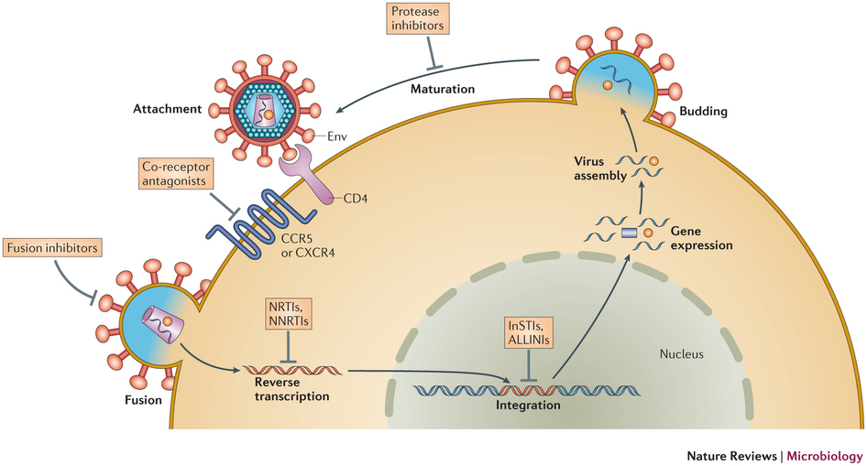
Human Immunodeficiency Virus
36.9 million currently infected around the world
Only 21.7 million persons with HIV are on ART
The large population living without ART generates a major consensus that an HIV cure is a necessity

Slide 4
Cures
Sterilizing Cure: complete eradication of HIV and infected cells from the body
The “Berlin patient” and the “London patient”
Boston patients
Functional cure: control of HIV infection without complete HIV eradication.
VISCONTI cohort teen
South African child
Mississippi Baby
Notes:
In over 10 years of cure research, we have only had two patients with sterilizing cures, the Berlin and London patients. In these cases we have discovered the radical means which are required for HIV cure are not applicable to the general population. They received bone marrow transplants from donors homozygous for CCR5 delta32 and the patients who underwent the same treatment without delta32 donors, the boston patients, did not achieve remission.
The other form of cure is the function cure … there have been a few cases of function cures, the Visconti cohort teens and the south African child which had very early ART intitiated and went off of ART. These individuals did not rebound, but there is no reason to believe they have achieved a sterilizing cure and we do not fully understand why they have controlled. Additionally very few of the Visconti cohort achieved remission and the Mississippi baby, who also had early ART rebounded, demonstrating the lack of a solid technique for preventing progression with early ART.

Slide 5
Obstacles For Cures
Obstacles for an HIV cure include:
  Rapid establishment of latent reservoir
  Reservoir is widely disseminated throughout the body
Obstacles for cure research:
  Technical: no marker has been determined
  Ethical: cannot stop therapy knowing the risks of disease progression or emergence of drug-resistant strains
    Recent findings in Analytic Treatment Interruptions have found that closely monitored cessation of treatment can be done safely.

Slide 6
“Kick and Kill”
Use of latency reversing agents to “kick” the virus out of latency
  HDACi, PKC agonists, bromodomain inhibitors etc.
Cells producing reactivated virus then get killed through either the cell-mediated immune response or viral lytic effects; the “kill” aspect

Slide 7
Romidepsin
Romidepsin (RMD); HDACi
  Used in treatment for cutaneous T-cell Lymphoma
  Shown to reactivate latent SIV
  Conflicting reports on HIV reactivation efficacy and the impact on immunological effects
    Cytotoxic T lymphocyte functionality may be hindered

Slide 8
Goals
To optimize dosing and assess the impact of repeated RMD administrations on the size of the latent SIV reservoir in an in vivo model of elite controllers: RMs infected with SIVsab
Hypothesis: Repeated dosing of romidepsin will progressively decrease the size of the reservoir, which will be observed as subsequent loss of reactivation potency at each round of treatment
By utilizing an in vivo model of SIV latency, whereby SIV is controlled through a healthy cellular immune response, we should see greater reservoir clearance with treatment.
The change from single administrations of RMD to “double doses” should further boost the extent of viral reactivation, thus allowing for a larger clearance of the reservoir relative to single dose regimens.

Slide 9
Approach
Experimental approach:
Five RMs were IV-infected with 300 TCID50 SIVsab
RMs received up-to 5 rounds of RMD (7 mg/m²) after viral control
  The first three rounds were single doses
  All remaining rounds were two doses separated by 1 day, “double doses”
Two RMs received CD8-depleting antibody (M-T807R1) to assess remaining reservoir after no rebound following the third romidepsin treatment

Slide 10
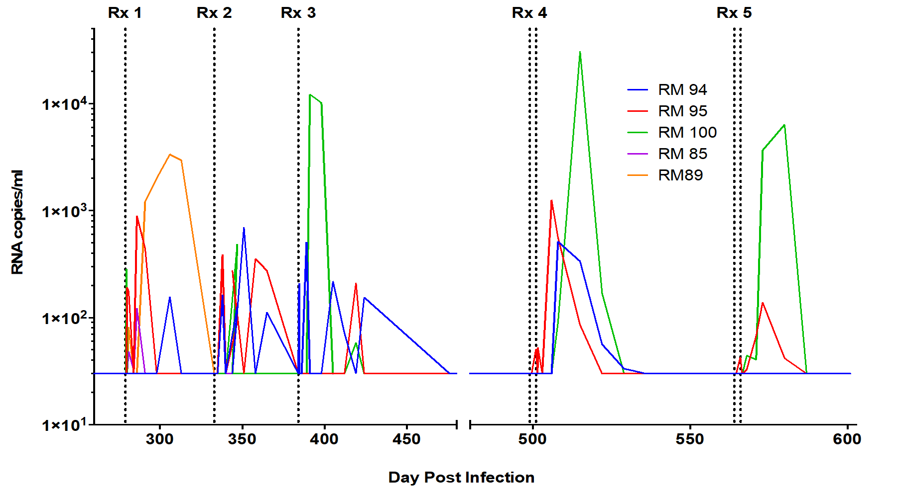
Plasma Viral Loads
Postinfection

Slide 11
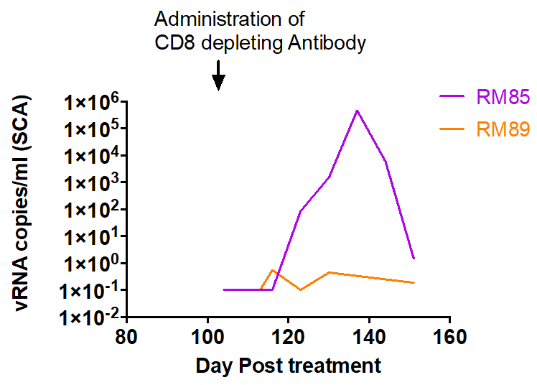
Plasma Viral Loads-CD8⁺ Depletion
-
-

Slide 12
T-cell Dynamics
3000
1000
Postinfection
Postinfection

Slide 13
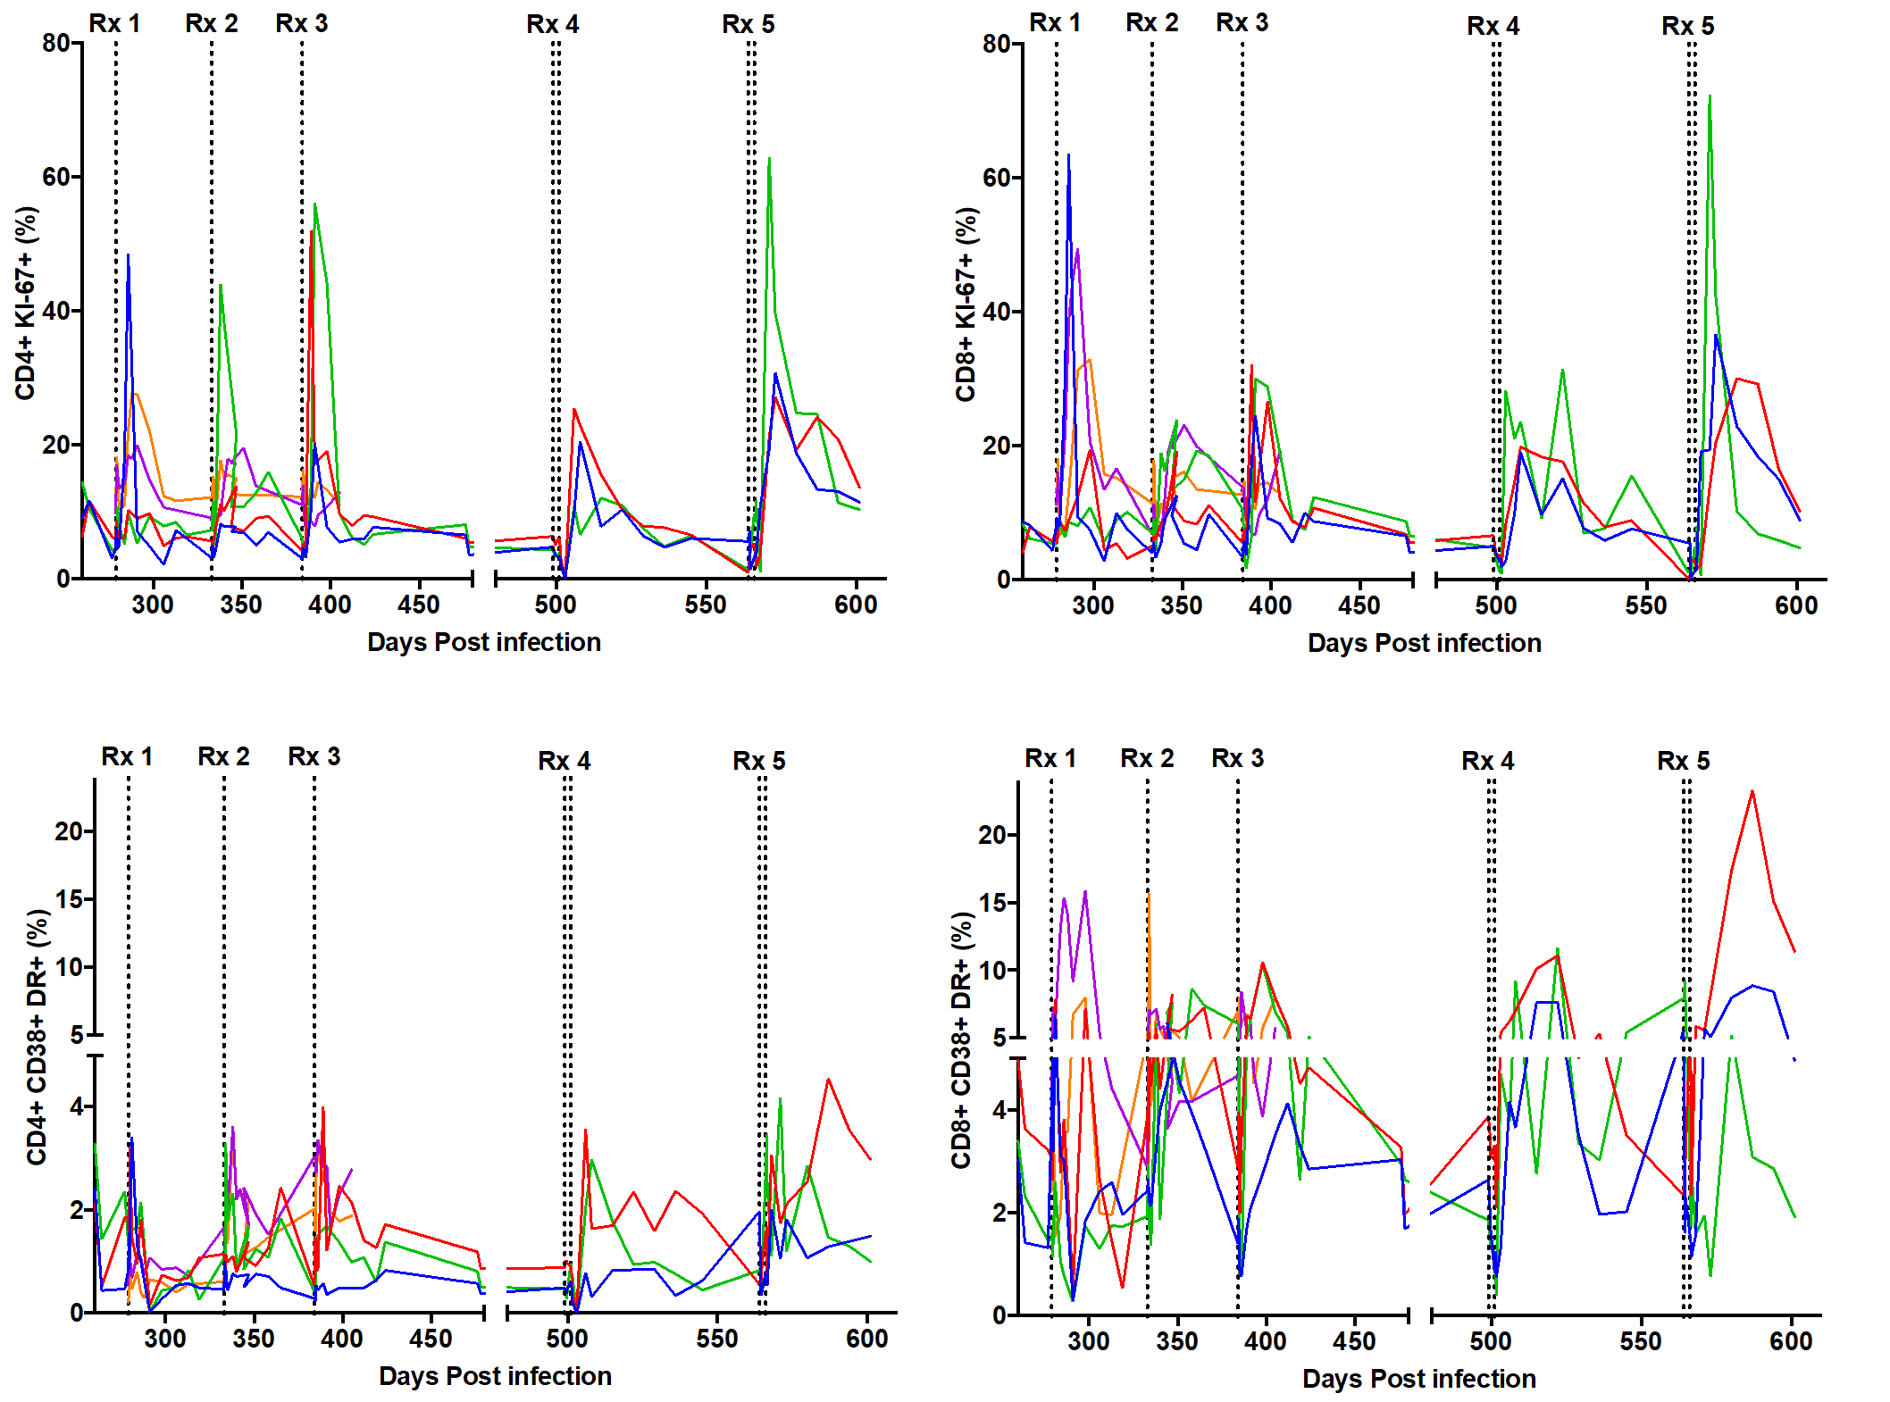
Immune Activation
Postinfection
Postinfection
Postinfection
Postinfection

Slide 14
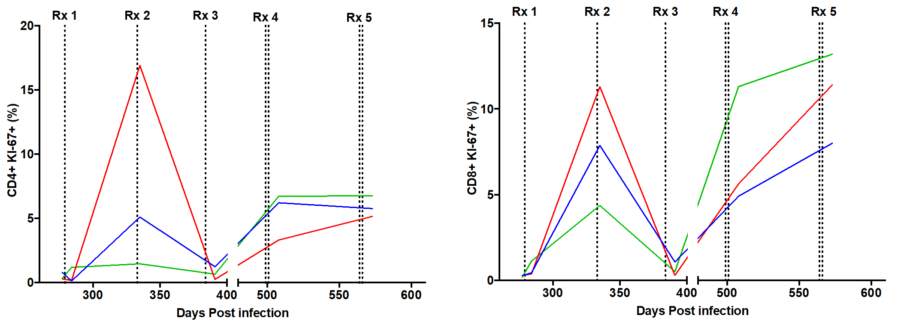
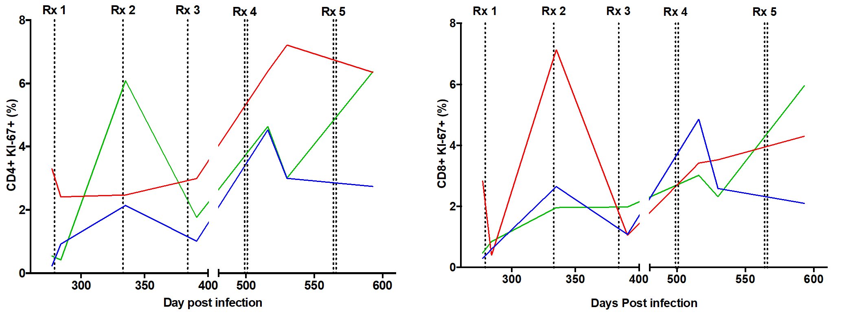
Tissue Immune Activation
Superficial Lymph Nodes
Postinfection
Postinfection
Intestinal Biopsies
Postinfection
Postinfection

Slide 15
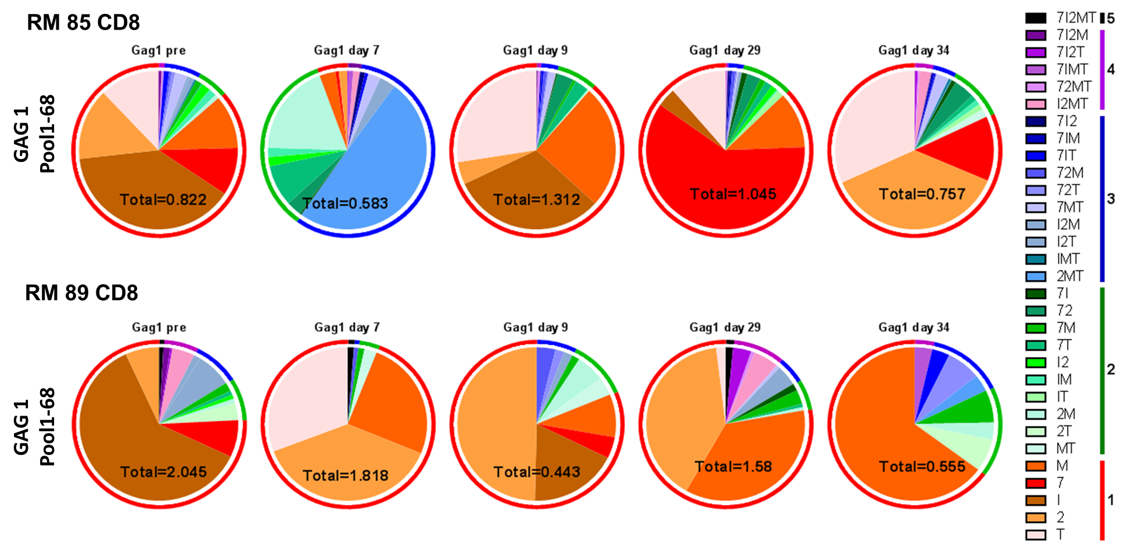
SIV-Specific Immune Responses
Notes:
As you can see from the graphs, the total amount of cytokines being produced decreases post treatment. Although the percentage of cells producing multiple cytokines vs a single cytokine increased in one animal, the overall amount of cytokines being produced was still lowered. However, none of the changes were significant.

Slide 16
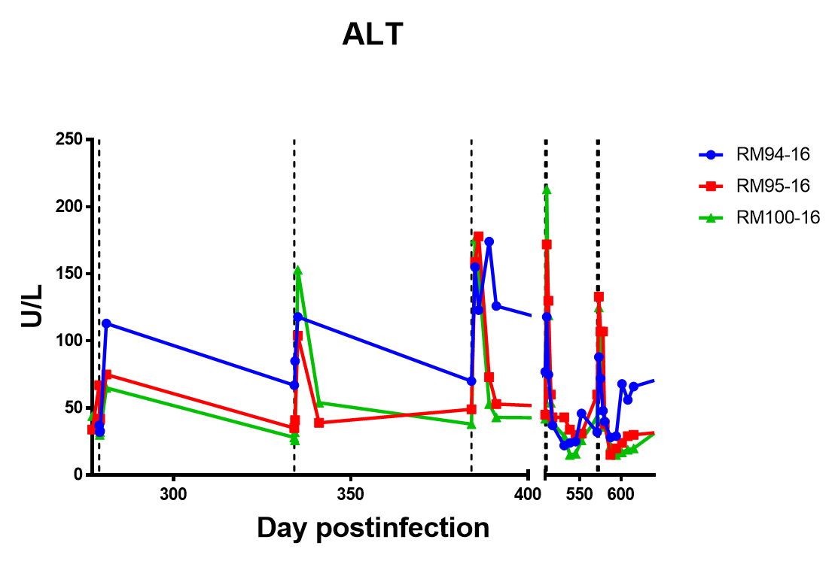
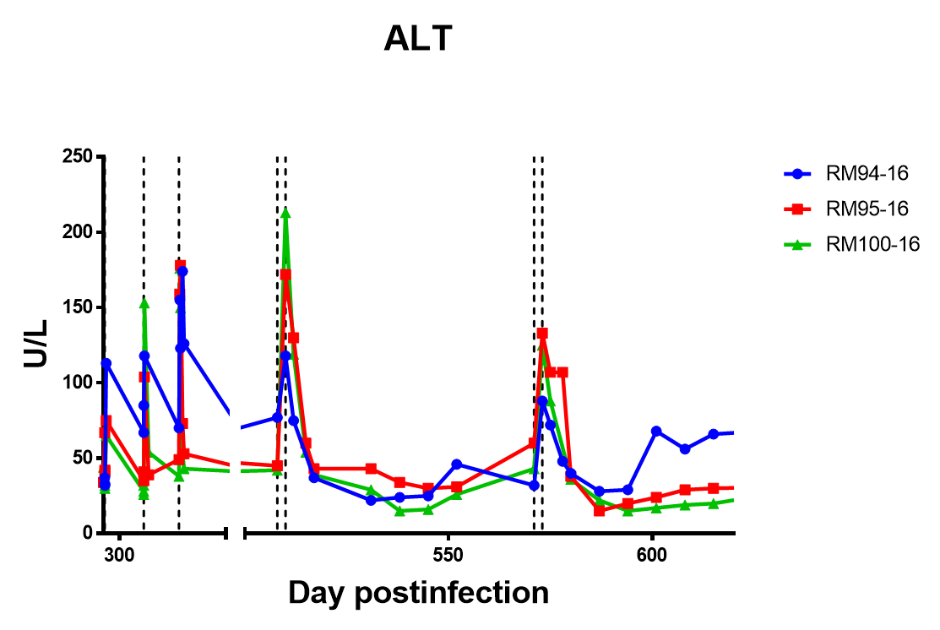
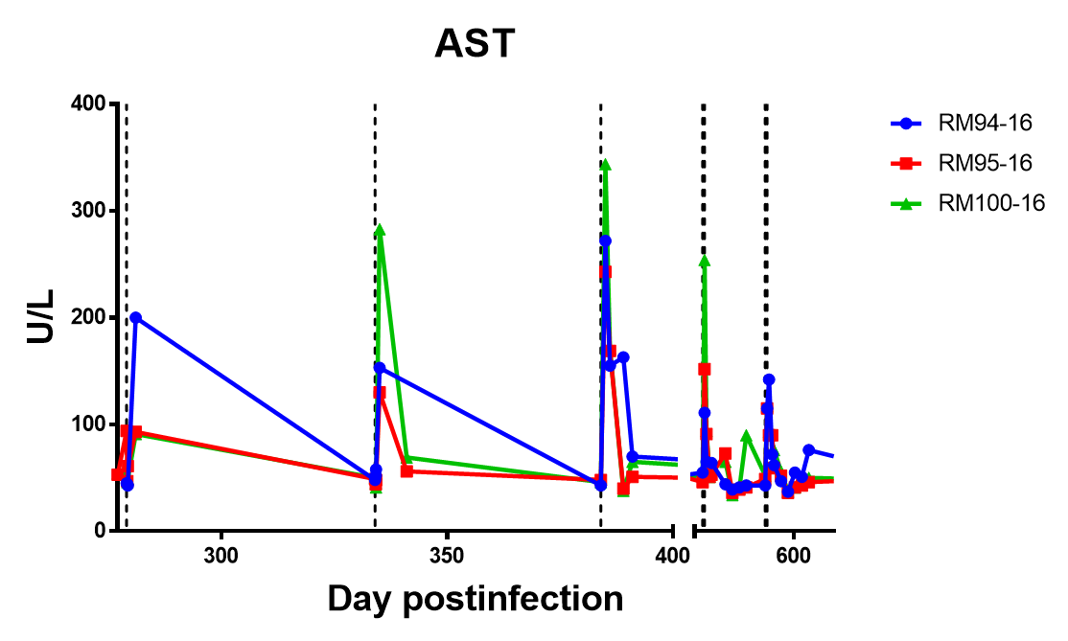
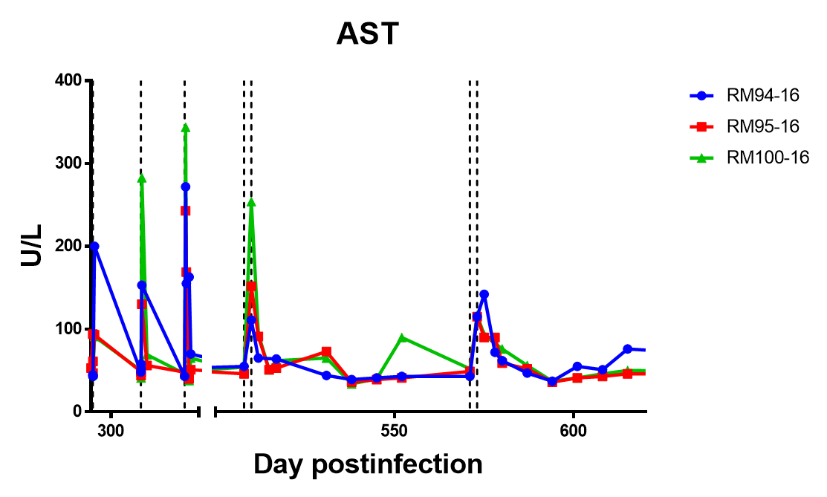
Toxicities
ALT
500
AST
500

Slide 17
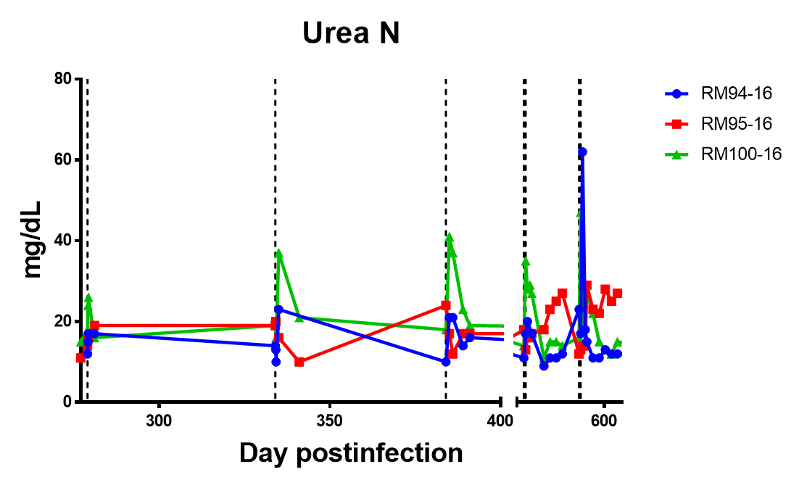
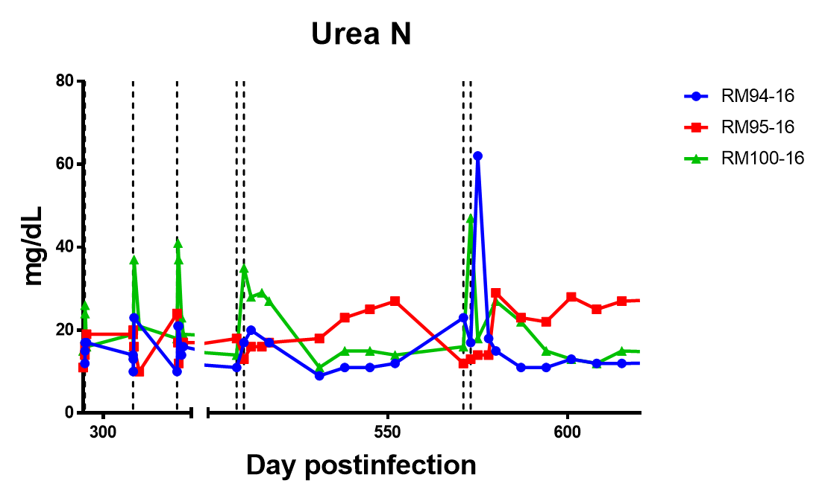
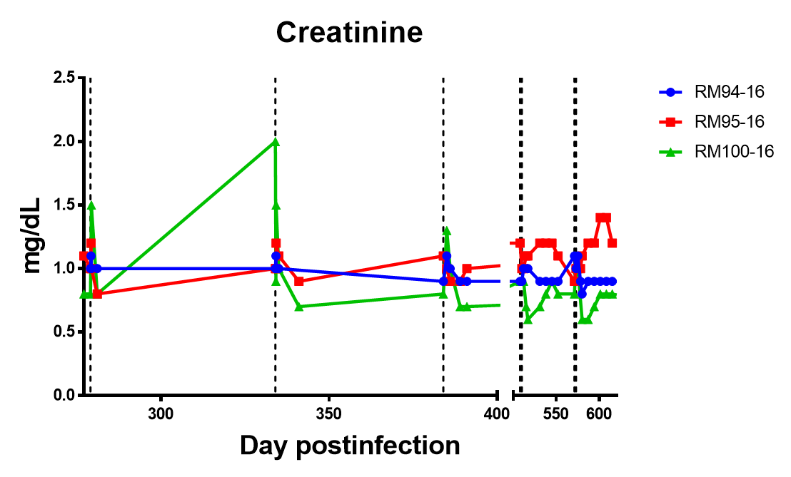
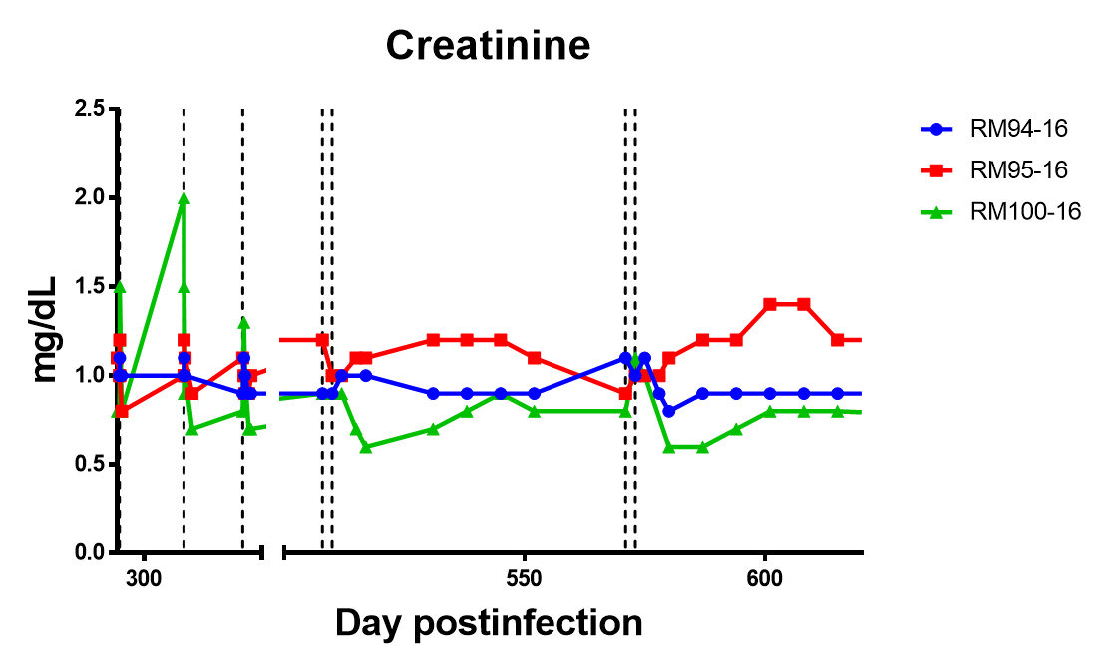
Toxicities
Urea Nitrogen
500
Creatinine
500

Slide 18
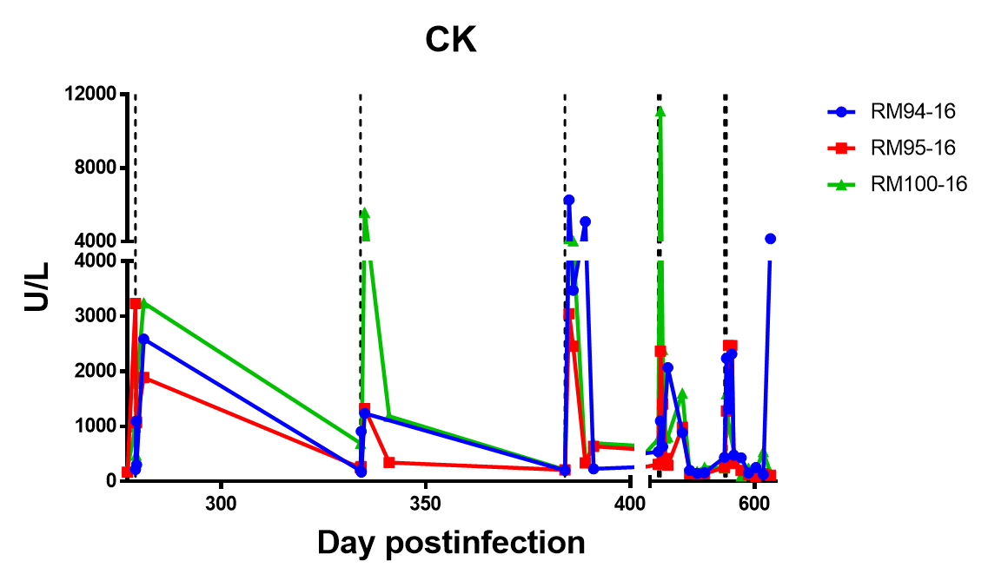
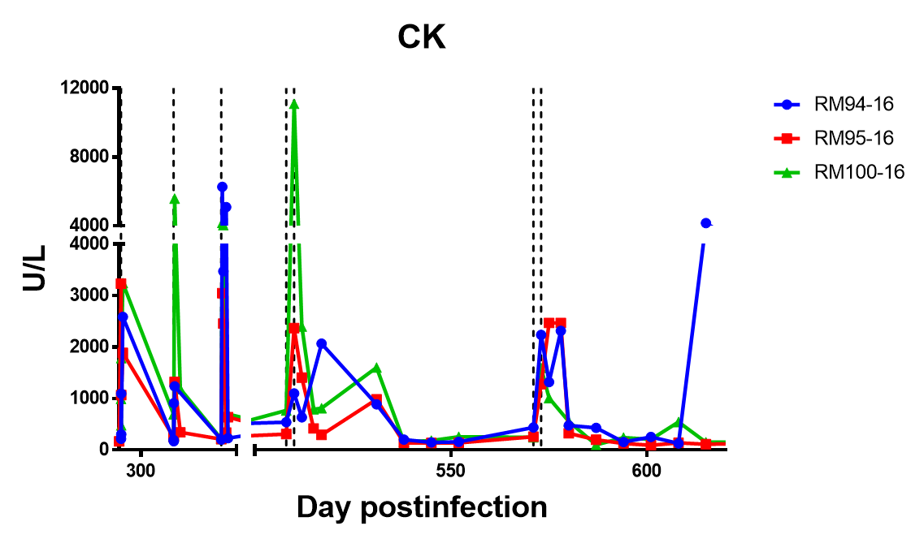
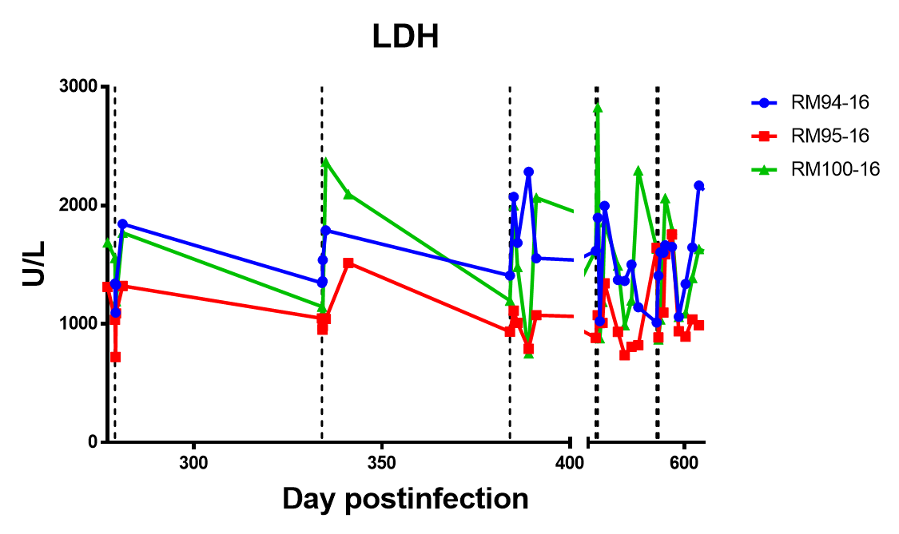
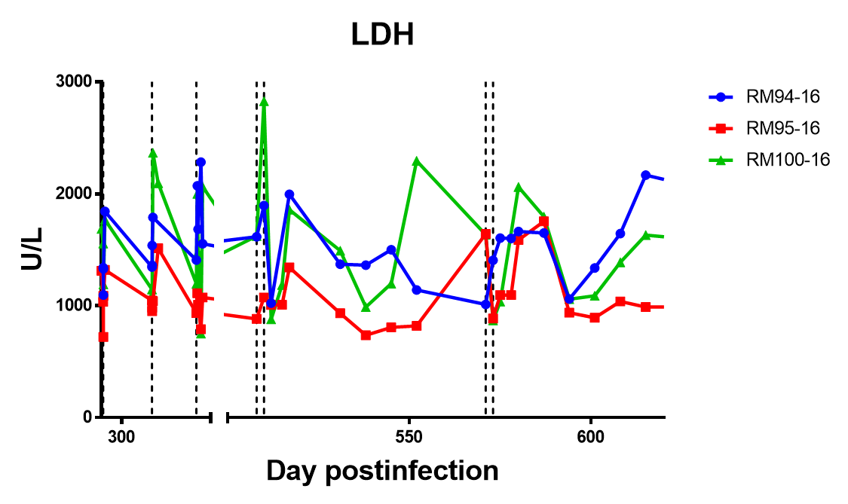
Toxicities
Creatinine Kinase
500
Lactate Dehydrogenase
500

Slide 19
Conclusions
In the context of a healthy immune response, RMD treatments lead to reactivation in rhesus macaques
The “double doses” did increase viral reactivation, but not immune activation
RMD decreased SIV-specific immune responses
RMD treatment was associated with moderate hepatotoxicity and a minimal nephrotoxicity
Repeated treatments had decreased viral reactivation each round and lack of reactivation from CD8 depletion suggests our intervention can impact the viral reservoir
Further studies with this intervention must take into consideration the toxicities and findings by the Mellors group that multidose romidepsin (5 mg/m²) did not induce HIV expression in patients suppressed on ART

Slide 20

Acknowlegements
Apetrei/Pandrea lab
Dr. Sindhuja Murali Kilapandal Venkatraman
Ellen Penn
Dr. Ranjit Sivanandham
Dr. Egidio Brocca-Cofano
Dr. Benjamin B. Policicchio
Dr. Paola Sette
Dr. Cuiling Xu
Tammy Dunsmore
Dr. Teodora Popovic
Dr. Ivona Pandrea
Dr. Cristian Apetrei
Pitt DLAR
Dr. Anita Trichel
Dr. Angela Kashuba lab
Dr. Mackenzie Cottrell
John Dohnal
Dr. John Mellors
IAS 2019 and the Scholarship Team
This work was funded by :
R01 AI119346 (CA), NIH training grants T32 AI065380 (AK) and T32 AI060525 (AK)

